Slide 1
COMPSCI X433.3 Python for Data Analysis and Scientific Computing
Project Presentation: Edmunds-Consumer Car Ratings and Reviews

Slide 2
Edmunds-Consumer Car Ratings and Reviews
Goal: Analyze the Review
We want to analyze if the reviews review similar car but rate them differently due to where they were manufactured?
We want to analyze if the reviews review rating behaviour changed with time, as new car models were better equipped with features.
Analyze tendency of reviewer, if they review latest cars or older cars
Knowing the dataset, we see there are three major car manufacturing regions with distinct car features.

Slide 3
Context-
This is a dataset containing consumer's thought and the star rating of car manufacturer/model/type.
Content- Currently, this dataset has data of 62 major brands.
Acura
AlfaRomeo
AMGeneral
Aston Martin
Audi
Bentley
BMW
GMC
Toyota
Volkswagen
honda
Bugatti
Buick
Cadillac
Chevrolet
Chrysler
Daewoo
Dodge
Eagle
Ferrari
FIAT
Fisker
Ford
Genesis
Geo
HUMMER
Hyundai
INFINITI
Isuzu
Jaguar
Jeep
Kia
Lamborghini
Land Rover
Lexus
Lincoln
Lotus
Maserati
Maybach
Volvo
Tesla
Suzuki
Subaru
Spyker
smart
Scion
Saturn
Mazda
McLaren
Mercedes-Benz
Mercury
MINI
Mitsubishi
Nissan
Oldsmobile
Panoz
Plymouth
Pontiac
Porsche
Ram
Rolls-Royce
Saab

Slide 4


1. Dataset
Each car dataset is a separate CSV file with following columns.
Review_Date
Author_Name
Vehicle_Title
Review_Title
Review
Rating Do we need all Columns for our Analysis and if the data is clean?

Slide 5
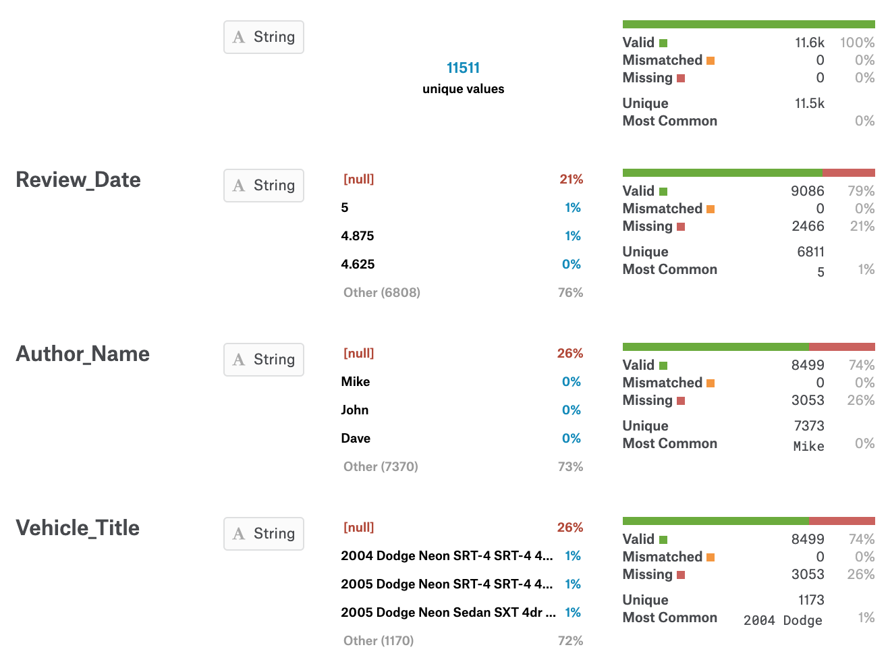
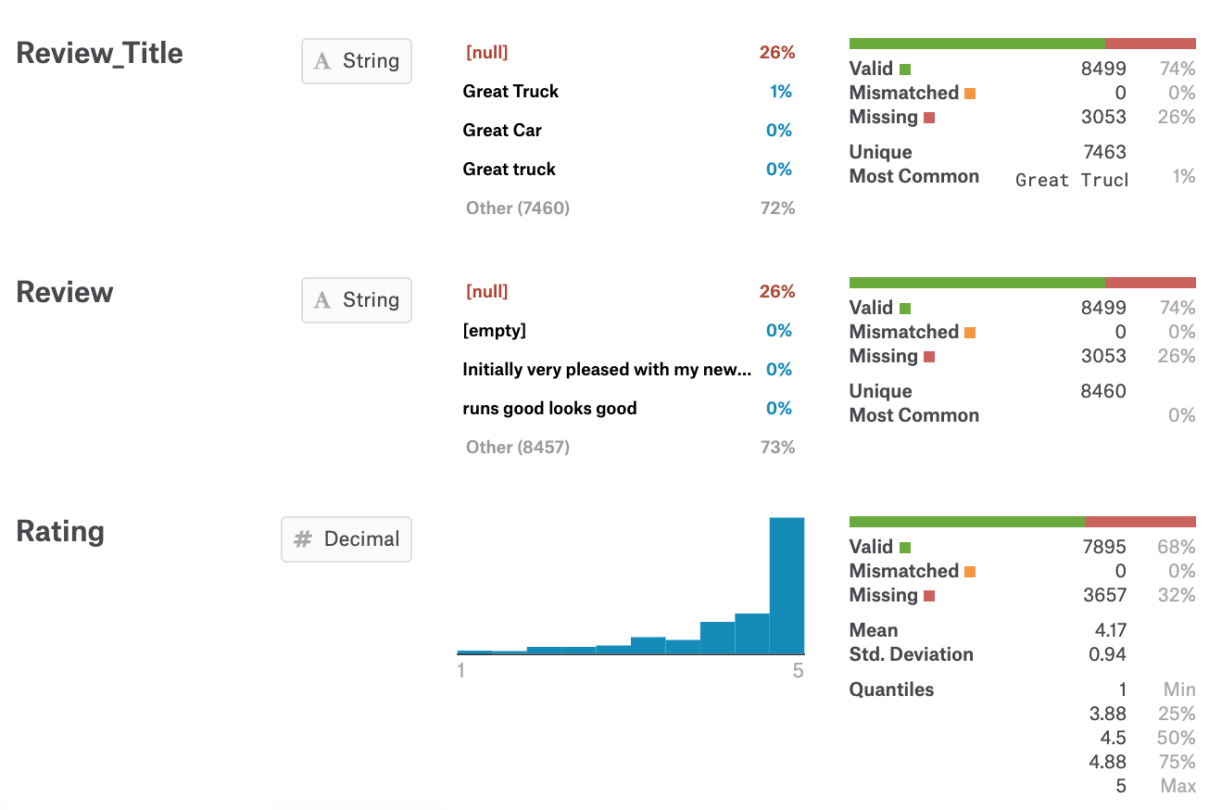
Column Properties

Slide 6
Review_Date:
This is a object, need to clean and transform to datetime.
Author_Name: In order to understand the behaviours, we need to retain Authors
Vehicle_Title:
We need to extract Year of Manufacturing as separate column. Rest we can discard.
Review_Title:
We can drop the data, as we are not doing sentiment analysis
Review:
We can drop the data, as we are not doing sentiment analysis
Rating:
We will keep the data but convert them to categorical data with only ratings in
whole number
Dataset: Analysis and Cleanup
Dataset: Cleaned
After cleaning dataset we are going to be left with Review_Date, Author_Name, Rating and Model_Year

Slide 7
Analyze the data quality and inconsistencies and address them
Findings:
Review_Date: Some review date were in format which cannot be converted to Datetime
Author_Name: Reviewers provided review anonymously
Rating: Rating is continuous variable with decimals, which causes too many data points
Model_Year: Some Car details were missing Model year.
Rating: Some reviewers, provided review comments but did not provide rating.
What’s Next
Tip
Different columns has different reason for missing data or inconsistent data. So the approach would be different.

Slide 8
How data were fixed
Review_Date:
For missing review date, we looked for Model year and populated it as Review Date and also used forward fill if Model year is missing.
Author_Name:
Reviewers provided review anonymously, so for all missing Authors, we added Author as ‘anonymous’
Rating:
Fill the missing values with mean for the rating
Convert the rating to floor value
Model_Year:
Fetch the review year and populate as Model year
What’s Next
Tip
For Author Review tendency, we will retain the original dataset

Slide 9
Analyze Author Review Behaviour for cars from Different Region
How to Prepare Data
Add a column for all three dataset called Region
Find the missing data
Find columns from where we can extract data of interest
Fill NnN appropriately
Append all three dataset
Analysis
Group by Reviewer, Region and Model Year
Draw graph depicting the distribution of rating by Model year
Draw graph depicting the distribution of rating by Region
Look top reviewed and their average rating given
Explore if they are consistently reviewing cars across the board
Conclusion
Most of the reviews were submitted anonymously
99% time, reviewers rate 5 for cars. That gives an idea that happy reviewers tends to review more than unhappy
Cars across the region tends to get consistent reviews
Top 3 reviews shows come inconsistent behavior, they provided all of their rating 5 and in same year

Slide 10
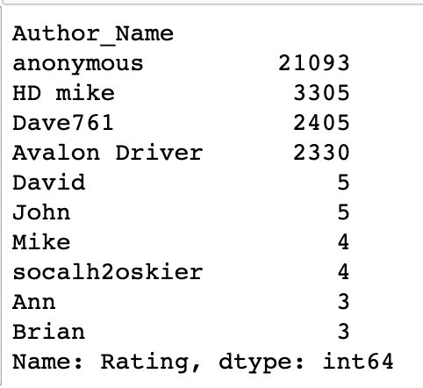

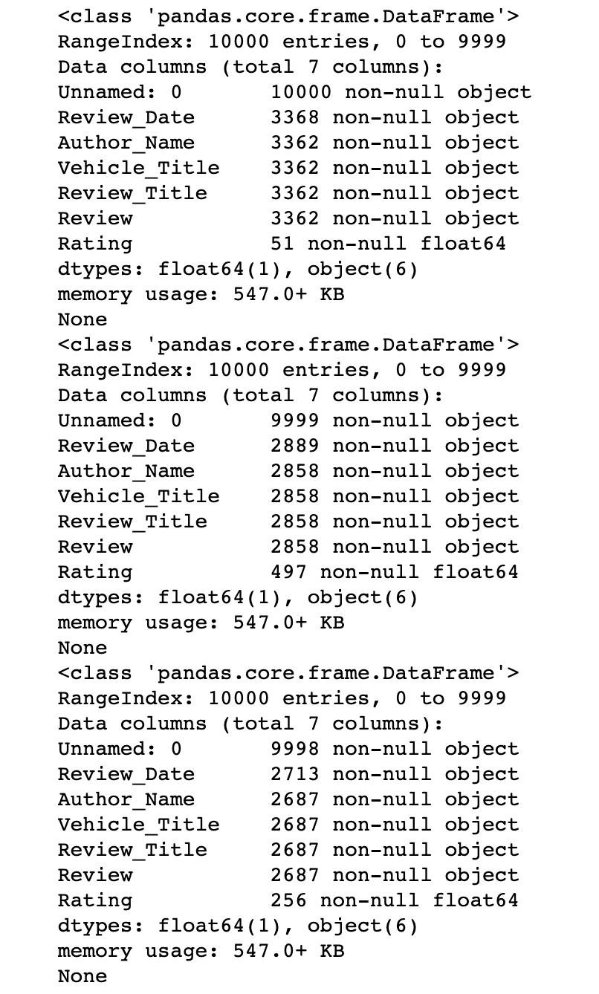


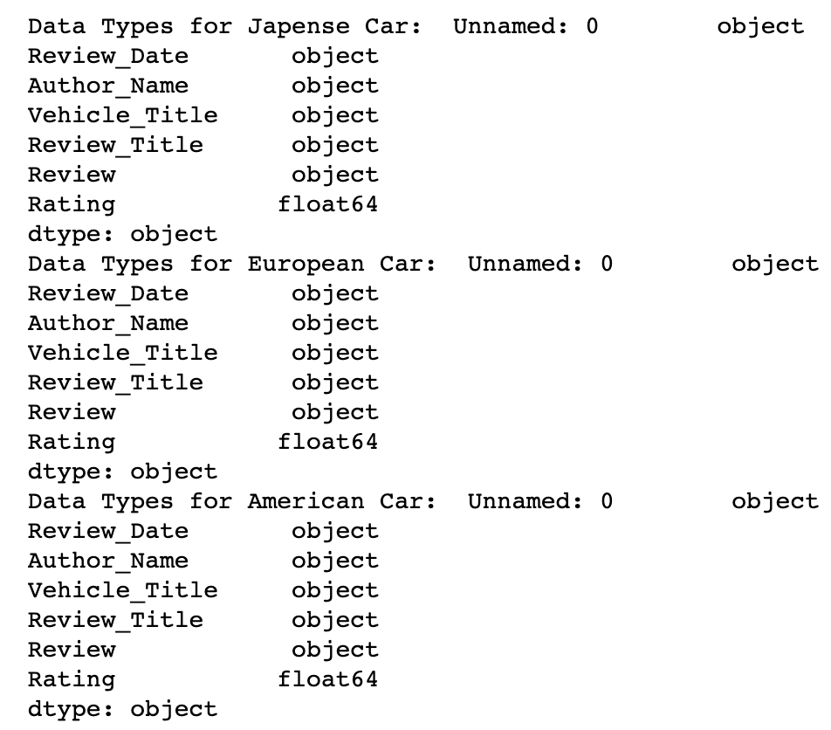
Some Outputs

Slide 11
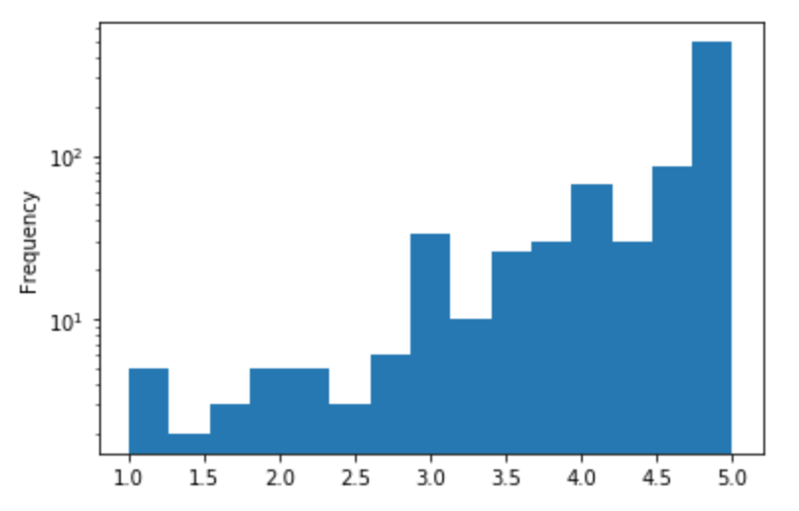
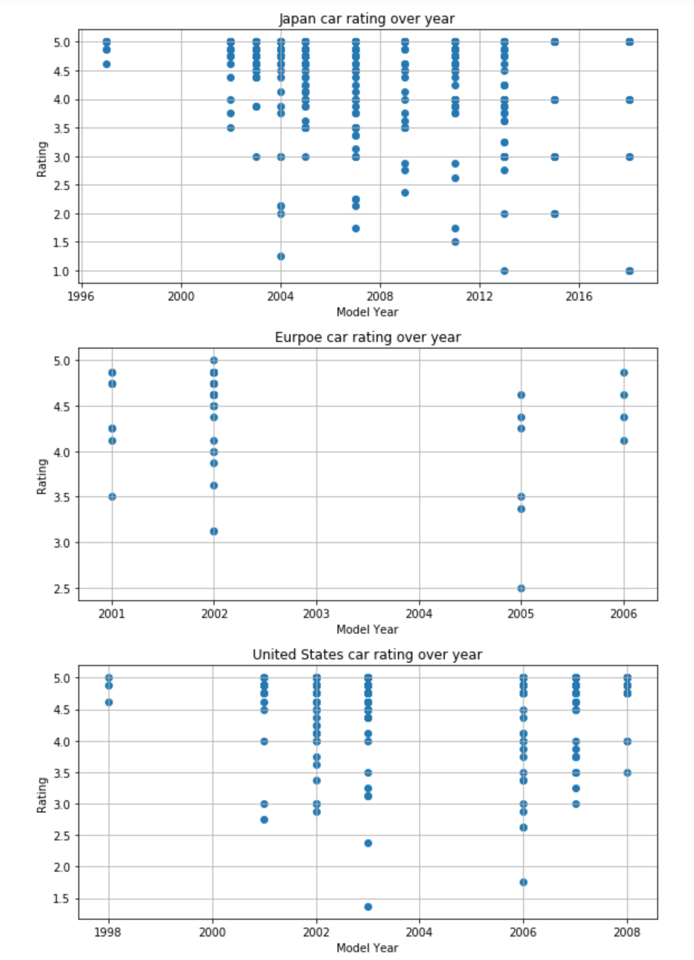
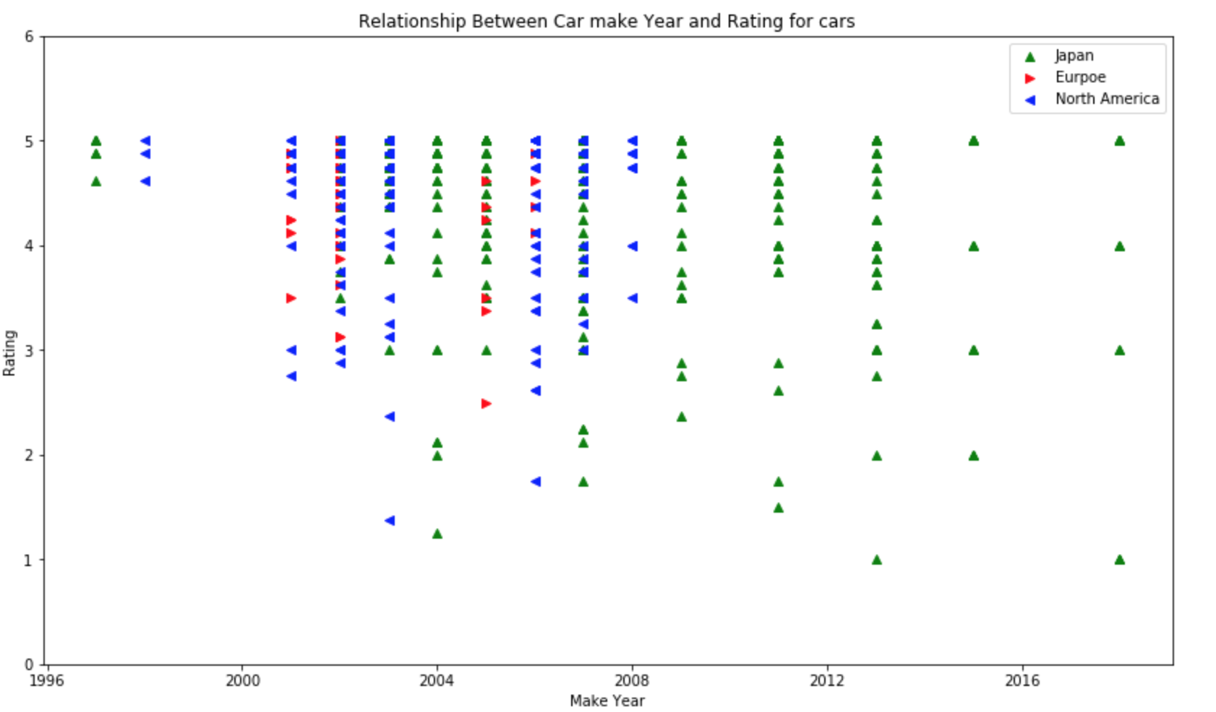
Some Graphs

Slide 12
What can we conclude
Happy customers tends to review more than unhappy. 99% of reviews were rated as 5
Some inconsistencies in data shows that top reviewers only provided rating of 5 and they have all of their rating for specific car and in same year
Cars across region and over years tends to get consistent reviews.
The Rating is not evenly distributed (not a normal distribution). It's positively skewed
Rating as integer are not best indicator, so keep it fractional value
Learning about reviewer’s review pattern is not possible with the data provided as most of the review are provided anonymously
Big share of the information in the dataset is in form of descriptive set. Which makes it a good candidates for sentiment analysis.

Slide 13
Data has many columns, big chunk of the information in the dataset is in form of descriptive set. Which makes it a good candidates for sentiment analysis.
There is enough data about 5% of total data where we have enough information to look into ratings and explore how rating were awarded, what things influenced the rating like Where car technology originated e.g. Asia (japan), Europe or USA.
The Rating dataset (subset of data cleaned up for Rating analysis) has some anolmolies
The Rating is not evenly distributed (not a normal distribution). It's more negatively skewed
Lot of review were provided anonymously, so making it difficult to identify reviewer pattern.
Most of reviewers have reviewed same car for multiple times (1-5), so we cannot predict the reviewer bias about a given car or any comparison for same reviewer reviewing different cars. Which kind of make sense that user in japan would not have multiple cars to use and provide review.
There were few reviewer anomalies where in one year few reviewers have reviewed 2000-3000 review for same car and all 5 rating.
Rating density distribution increases from 4 - 5.
Different cars across region has consistent rating across the decade. Average rating remained same.
Japan cars have slightly higher 99th percentile (5.0) rating and European / American (4.5 - 4.8)
Key Observations

Slide 14
Next Steps
Extract additional data which can be used as features for analyzing and predicting the ratings, for example
From Car Title extract
Engine Power
Doors in Car
Gasoline (Petrol vs Diesel)
Include all cars datasets, and do more analysis to see if we can find reviewers are reviewing more than one car model or not.
Create a model which can predict a car rating based on car Make Year, Model, Engine Type and number of doors
Warning
If we want to include all 64 different car models and all data, it would need significant computing resources.

Slide 15
Feedback
Share your feedback to improve my analysis

